Slide 1

Musical Chord Progression analysis
Thomas Burless
John Culhane
Mario Iglesias
Janice Javier
Morgan Tosini

Slide 2
What are we doing?
We are looking at the some of the more popular songs in history through different genres and seeing if there are specific chord progressions that are used in these songs
Do people like to listen to a certain chord progression without noticing?
Do popular chord progressions differ by country?
Which chord progressions do we see the least in popular music?
Do artists release certain songs as singles because they know it uses a specific chord progression that will fair well with audiences?
Does most popular music genre differ by country?

Slide 3
Musical CHORD PROGRESSION
A series of chords played in a sequence. Each chord is a harmonic function within a key, which means to compare the chord to the tonic of the key
Chord progressions help to establish a harmonic path for the melody to surf on top of
Chord progressions are the foundations for some music styles such as Rock, Jazz, and Blues
  In pop music, chord progressions may unfold over a line of lyrics then loop back; whereas in jazz a chord progression may never loop in a song. We will see examples of this later on

Slide 4
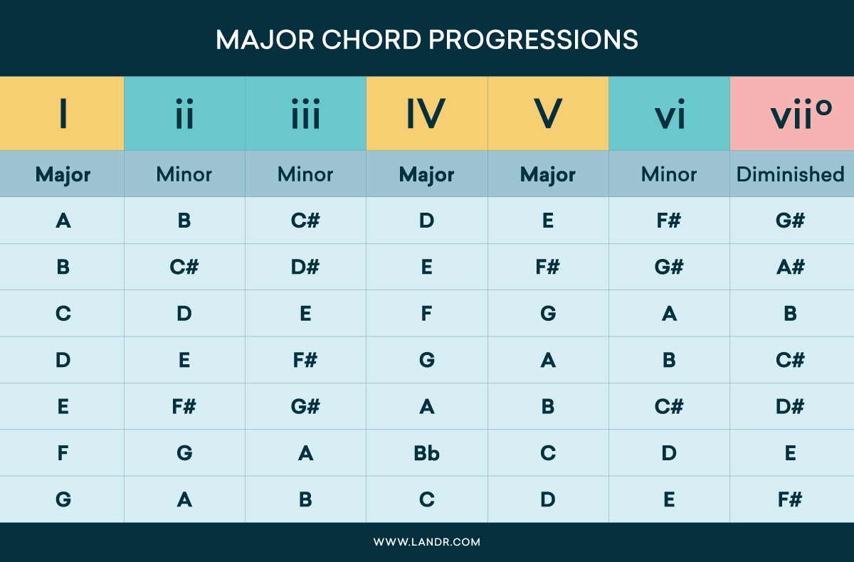
Different types of chord progressions

Slide 5
OUR PREDICTIONS
*Insert John’s answer* will be the most popular chord progression because *insert answer*
Chord progression popularity will differ by country and so will genre
Artists do release certain songs based off of chord progression that they produce to try to predict which will be the most popular

Slide 6
Application programing interfaces
Spotify’s API
Last.FM
HookTheory

Slide 7
Data exploration
Spotify
  Top 200 list by Country (2019)
  Popularity Metric
  Release Date
Last.fm
  Track.getInfo
  topTags
  Search
HookTheory
  Trend/songs

Slide 8
Suprises
HookTheory had a good amount of Japanese songs, as we though it would be very westernized

Slide 9
Query Examples
*Insert different API calls for each source and what made them work differently*

